Slide 1
Frequently asked questions

Slide 2
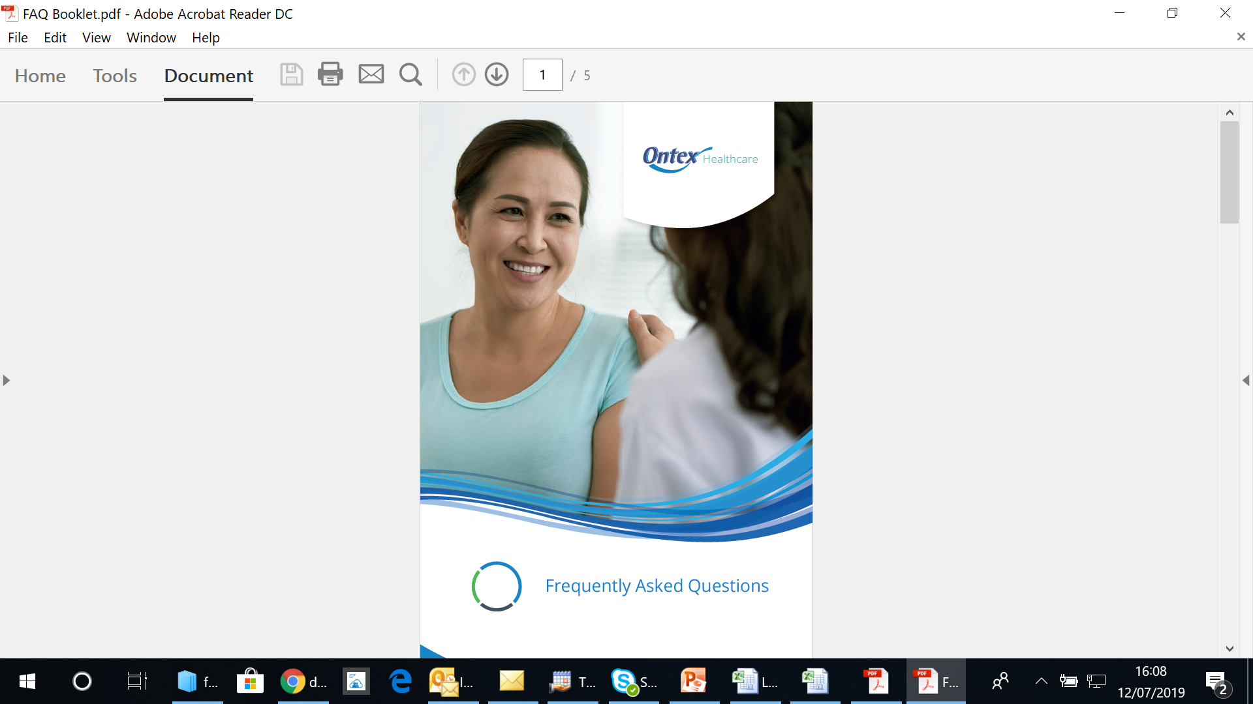
BY THE END OF THIS PRESENTATION YOU SHOULD BE ABLE T0
ANSWER THE FOLLOWING:
How do absorbent disposable body worn incontinence pads work?
What factors can inhibit pad absorption?
Why is there so many types of pad?
Can I flush disposable pads down the toilet?
Can pads stop smells happening? Do they have odour control?
How often should I change my residents pads?
Can you wear two pads at a time to increase the absorbency?
Can I apply the same pad after toileting the resident/patient?
Can I leave the same pad on overnight?
What should I check if the pad is leaking?
Should pads be shaken, fluffed or twisted prior to application?
Are there day pads and night pads?
Why does my pad look as if the pulp has clumped together?

Slide 3
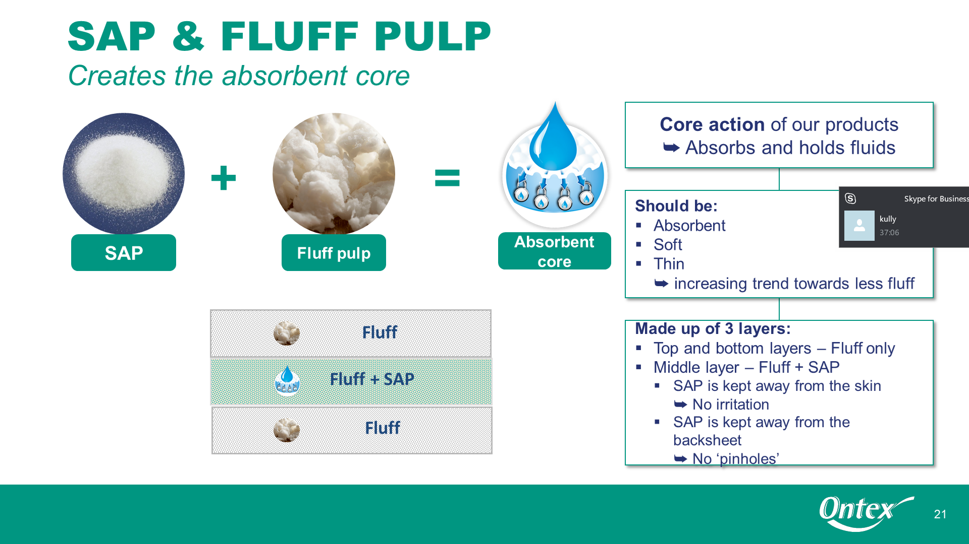
Question 1
How do absorbent disposable body worn incontinence pads work?
Absorbent disposable body worn pads contain two vital ingredients:
Super Absorbent Polymers (SAP) & Fluff Pulp, which work together to absorb and lock fluid away, preventing it returning to the skin.
Most of our pads also have anti-leak cuffs which act as barriers to prevent leakage.
Our SAP Absorbs up to 60 times its own weight
Our fluff pulp absorbs approx
10-15 times its own weight

Slide 4
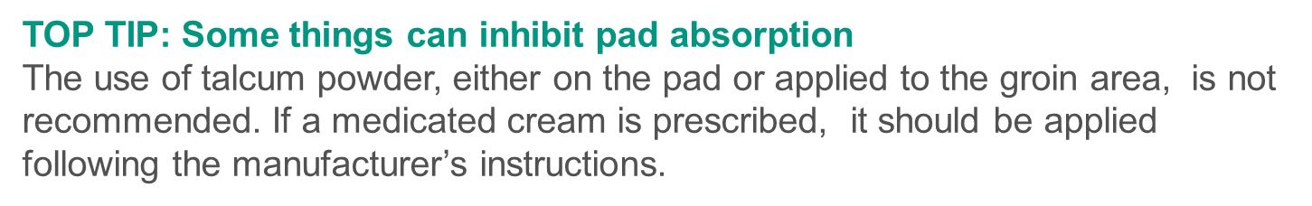
QUESTION 2
What factors can inhibit absorption?
Gently remove them from the outer packaging, opening them up and folding lengthwise to form a cup/gully for the groin area.

Slide 5
Question 3
Why is there so many types of pads?
People have different bladder capacities, types of incontinence and their body shapes vary, a Nurse will assess the correct pad for your needs.
That is why Ontex Healthcare make a variety of styles, sizes and absorbency of products to meet individuals needs.

Slide 6
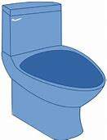
Question 4
Q. Can I flush disposable pads down the toilet?
No, definitely not (as I’m sure you already know).
If someone is living in their own home; used products should be placed into a plastic bag and dispose of in general household waste.
In care homes, and hospitals local policy for disposal should be followed.

Slide 7
Questions 5
Q. Can Pads stop smells happening?
Do they have odour control?
Our SAP Absorbs odour and up to 60 times its own weight
Our (SAPs) also contribute towards the effectiveness of our odour control system, which helps prevent unpleasant smells

Slide 8

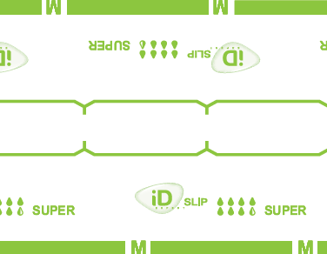
Question 6
Q. How often should I change my pad?
Know when to change
The yellow line will turn blue. The blue line or writing will fade
When approximately two thirds of the wetness indicator lines have changed colour the pad is ready to be changed.
TOP TIP: There is no need to remove the pad to check the Wetness Indicators. However, if there has been any faecal soiling then the pad should be changed immediately.
Glue / hotmelt
Changes from yellow to blue/green when wet
Printed
Blue line disappears as the pad is saturated

Slide 9
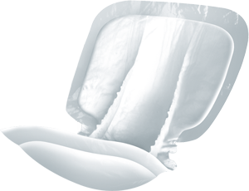
Question 7
Q. Can you wear two pads at a time to increase the absorbency?
No. The back of the pads are waterproof so fluid will not flow from one pad to another.
Wearing more than one pad can affect the skin and pressure areas by forming hard edges. There is no benefit from wearing more than one pad.
Wearing more than one pad is viewed as bad practice and can put skin and pressure areas at risk.

Slide 10
Question 8
Q. Can I apply the same pad after toileting?
Yes, as long as there is only urine in the pad and the product is intact.
Any evidence of faecal soiling, wound exudate or blood means the pad should be changed.
As long as two thirds of the wetness indicators have not changed colour
Glue / hotmelt
Changes from yellow to blue/green when wet
Printed
Blue line disappears as the pad is saturated

Slide 11

Question 9
Q. Can I leave the same pad on overnight?
Yes, you can leave a pad on overnight as long as:
There is only urine in the pad and the product is intact
There is no evidence of faecal soiling, wound exudate or blood
Two thirds of the wetness indicators have not changed colour
Please note in a care home/hospital environment it is important to check the wetness indicators at regular intervals (without disturbing the sleep) to ensure the pad will last.

Slide 12

Question 10
Q. What should I check if the pad is leaking?
Problem Solving
Check the following:
Correct size and style of fixation pants or underwear is essential
Correct waist size [if applicable]
Correct fitting of the pad
Correct absorbency of pad
If oil based cream has been used, has it been applied sparingly
Has the wetness indicators reached the maximum absorbency or not
Top Tips:
Where applicable Ontex Products are always measured at the waist.
In addition, some individuals can have an body shape that knowing their hip measurement may be useful when selecting product
Weighing the pad is also an option to find out if the pad has reached its maximum absorbency

Slide 13

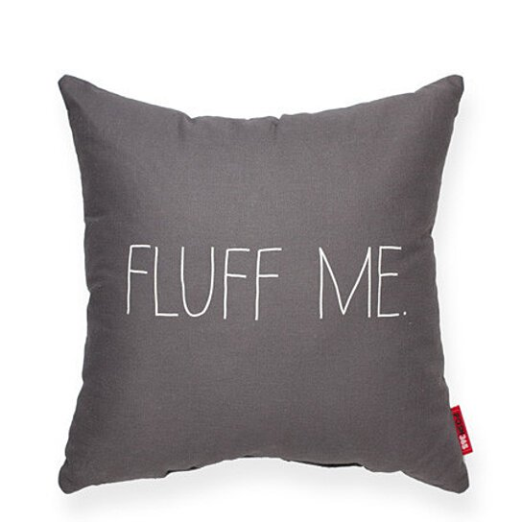
Question 11
Q. Should pads be shaken, fluffed or twisted prior to application?
No do not shake, Fluff up or Twist the pad prior to application
Due to the way pads are manufactured, this will cause the pad to break up and will move the position of the fluff and the SAPs. As a result, the pads will not function efficiently.
DO NOT

Slide 14

Question 12
Q. Are there day pads and night pads?
No there are no day pads and night pads
As people will pass varying amounts of urine throughout a 24 hour period it is important to establish their fluid intake and output to determine which product will need their needs.
The most absorbent pad is not always the night time pad. For example, someone who is taking a diuretic [water tablet] may require a higher absorbency or more frequent toileting.
Top Tip:
As well as your care plan, using Locker Stickers could indicate which pad your resident wears during the daytime and at night time

Slide 15

Question 13
Q. Why does my pad look as if the pulp has clumped together?
There are many reasons for the pulp clumping together:
The pad has been shaken prior to fitting
The pad is too high an absorbency for the users urine output. This can cause the SAPs to clump in one area of the pad
Loose fitting underwear can cause the pad to move, causing friction and shearing within the pad

